Slide 1
Method Types and Properties
Dirk Riehle, FAU Erlangen
ADAP B01
Licensed under CC BY 4.0 International

Slide 2
Agenda
Method types
Query methods
Mutation methods
Helper methods
Method properties
Implementation properties
Inheritance properties
Convenience methods
Design guidelines

Slide 3
Professional Language
To become a proficient developer, you need to learn the language
Not just a programming language, but how developers talk about code
Some of it can be found in textbooks, some cannot
It is always evolving so stay current

Slide 4
1. Method Types

Slide 5
Method Types
A method type classifies a method into a particular type
The method type is indicative of the main purpose
A method may have only one type, not many
(Also: A method should have one purpose)

Slide 6
Main Categories of Method Types
Query methods are
Methods that return information about the object but don’t change its state
Mutation methods are
Methods that change the object’s state but don’t provide information back
Helper methods are
Methods that perform some utility function independent of the object

Slide 7
Classification of Method Types
Query methods | Mutation methods | Helper methods
Get method (getter) | Set method (setter) | Factory method
Boolean query method | Command method | Cloning method
Comparison method | Initialization method | Assertion method
Conversion method | Finalization method | Logging method
... | ... | ...

Slide 8
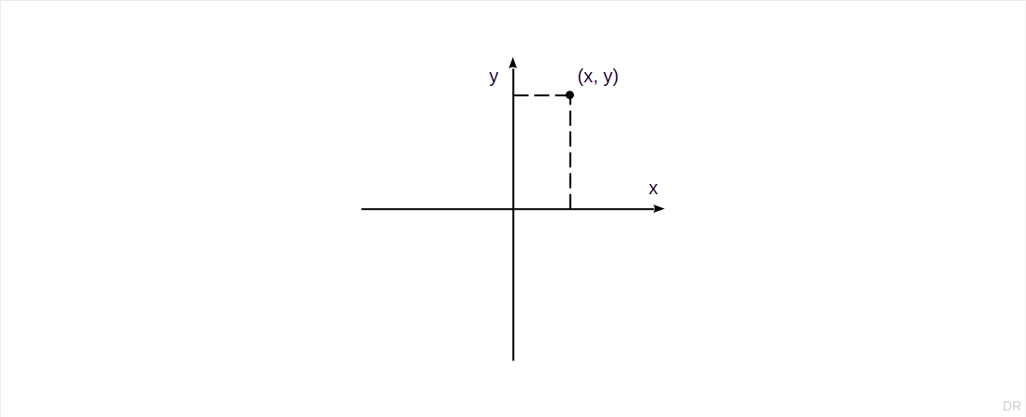
Cartesian Coordinates

Slide 9
A Simple Class for Cartesian Coordinates
export class Coordinate {
private x: number = 0;
private y: number = 0;
constructor(x?: number, y?: number) { ... }
public isEqual(other: Coordinate): boolean { ... }
public getX(): number { ... }
public setX(x: number): void { ... }
public getY(): number { ... }
public setY(y: number): void { ... }
public calcStraightLineDistance(other: Coordinate): number { ... }
...
}

Slide 10

Class Model of Cartesian Coordinate

Slide 11
2. Query Methods

Slide 12
Get Method (a.k.a. Getter)
A get method is
A query method that returns a logical field of the queried object
Example
getX(): number
Prefixes
get
Naming
Prefix + the name of the logical field

Slide 13
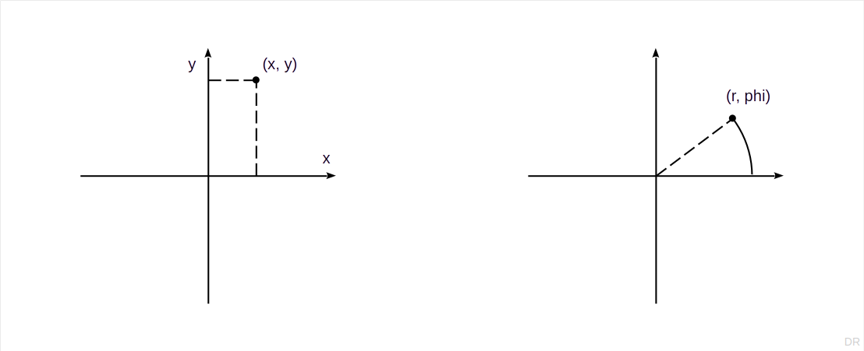
Cartesian and Polar Coordinates

Slide 14
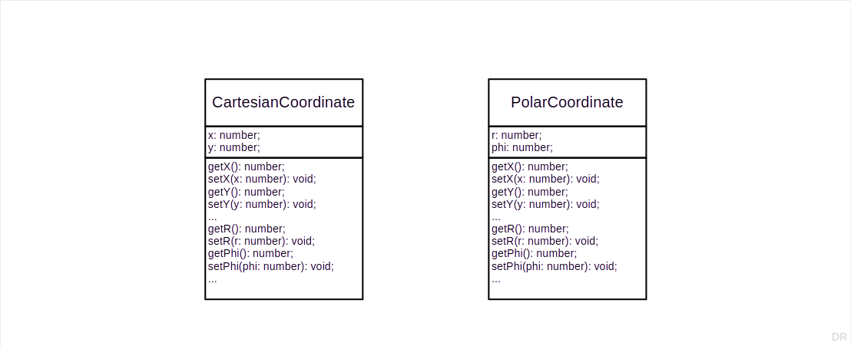
Cartesian and Polar Coordinate Classes

Slide 15
Logical vs. Technical State
Logical state (fields / attributes) is visible in the interface
Technical [1] (“implementation”) state is the actual fields in memory
[1] Also sometimes called physical

Slide 16
Get Method Examples
public getX(): number {
return this.x;
}
public getY(): number {
return this.y;
}
public getR(): number {
return Math.hypot(this.getX(), this.getY());
}
public getPhi(): number {
return Math.atan2(this.getY(), this.getX());
}

Slide 17
Boolean Query Method
A boolean query method is
A query method that returns boolean state about the queried object
Example
isEqual(): boolean
Prefixes
is
Naming
Prefix + the name of the state

Slide 18
Boolean Query Method Examples
public isEqual(other: Coordinate): boolean {
return (this.getX() == other.getX()) && (this.getY() == other.getY());
}

Slide 19
Equality
export interface Equality {
isEqual(other: any): boolean;
getHashCode(): number;
}

Slide 20
Equality Contract
Two equal objects must have the same hashcode

Slide 21
Equality Implementation
public isEqual(other: Coordinate): boolean {
return (this.getX() == other.getX()) && (this.getY() == other.getY());
}
public getHashCode(): number {
let hashCode: number = 0;
const s: string = this.asDataString();
for (let i = 0; i < s.length; i++) {
let c = s.charCodeAt(i);
hashCode = (hashCode << 5) - hashCode + c;
hashCode |= 0;
}
return hashCode;
}
public asDataString(): string {
return this.getX() + "#" + this.getY();
}

Slide 22
Comparison Method
A comparison method is
A query method that compares to objects on an ordinal scale
Example
compareDistance(other: Coordinate): number // to origin
Prefixes
None specifically
Naming
Prefix + what is being compared

Slide 23
Comparison Method Example
public compareDistance(other: Coordinate): number {
let thisR = Math.hypot(this.getX(), this.getY());
let otherR = Math.hypot(this.getX(), this.getY());
if (thisR == otherR) {
return 0;
} else if (thisR < otherR) {
return -1;
} else {
return 1;
}
}

Slide 24
Conversion Method [1]
A conversion method is
A query method that returns a different representation of the object
Example
asDataString(): string
Prefixes
as, to
Naming
Prefix + target type
[1] Better, but less common: Interpretation Method

Slide 25
Conversion Method Example
public toString(): string {
return this.asDataString();
}
public asDataString(): string {
return this.getX() + "#" + this.getY();
}

Slide 26
The Ambiguous Semantics of toString(): string
Is it made for
Users (= human-readable representation of object) or
Machines (= machine-readable representation of object)?
Is it used in an end-user UI, in a database, or a debugger?
Our interpretation is that toString() is for developers and machines, not users

Slide 27
3. Mutation Methods

Slide 28
Set Method
A set method is
A mutation method that changes a logical field of the object
Example
setX(x: number): void
Prefixes
set
Naming
Prefix + name of logical field

Slide 29
Set Method Examples
public setX(x: number): void {
this.x = x;
}
public setY(y: number): void {
this.y = y;
}
public setR(r: number): void {
let phi: number = Math.atan2(this.getY(), this.getX());
this.setX(r * Math.cos(phi));
this.setY(r * Math.sin(phi));
}
public setPhi(phi: number): void {
let r: number = Math.hypot(this.getX(), this.getY());
this.setX(r * Math.cos(phi));
this.setY(r * Math.sin(phi));
}

Slide 30
Command Method
A command method is
A mutation method that makes a complex change to an object's state
Example
multiplyWith(other: Coordinate): void
Prefixes
make, handle, execute, perform, ...
Naming
Prefix + descriptive term about the action

Slide 31
Command Method Examples
public multiplyWith(other: Coordinate): void {
let newR = this.getR() * other.getR();
let newPhi = this.getPhi() + other.getPhi();
this.setR(newR);
this.setPhi(newPhi);
}

Slide 32
Remove vs. Delete
A remove command
Removes an element from its context, but does not delete it
A delete command
Deletes the element, invalidating any other references

Slide 33
Initialization Method
An initialization method is
A mutation method that sets some or all of the state of an object at once
Example
initialize(x: number, y: number): void
Prefixes
init, initialize
Naming
Prefix + the part of the object being initialized

Slide 34
Initialization Method Example
public initialize(x?: number, y?: number): void {
if (x != undefined) {
this.x = x;
}
if (y != undefined) {
this.y = y;
}
}

Slide 35
4. Helper Methods

Slide 36
Object Creation Methods
An object creation method is
A helper method that creates an object and returns it
A factory method is
An object creation method that creates an object by naming the class
A cloning method is
An object creation method that creates an object by cloning an object
A trader (also: trading) method is
An object creation method that creates an object from a specification

Slide 37
Factory Method
An factory method method is
An object creation method that creates an object by naming the class
Example
createCoordinate(x: number, y: number): Coordinate
Prefixes
create (also: new, make)
Naming
Prefix + some identification for the new object

Slide 38
Factory Method Example
public createOrigin(): Coordinate {
return new Coordinate(0, 0);
}

Slide 39
Create vs. Ensure
A create command guarantees a new object
createLocationCoordinate(): Coordinate;
An ensure command guarantees a specific cardinality of the requested object
ensureLocationCoordinate(): Coordinate;
Create creates, ensure may or may not create a new object

Slide 40
Cloning Method Example
export interface Cloneable {
clone(): Object;
}
public clone(): Coordinate {
return { ...this };
}

Slide 41
Shallow vs. Deep Cloning
A shallow clone of an object is a clone with
All attribute values being identical between original and clone
All object references pointing to the originally referenced objects
A deep clone of an object is a clone with
All attribute values being identical between original and clone
All referenced but not owned objects pointing to their originals
All owned / composed objects being deep clones of the originals

Slide 42
Assertion Method
An assertion method is
A helper method that asserts a condition holds or throws an exception
Example
assertIsValidPhi(phi: number): void
Prefixes
assert
Naming
Prefix + condition being asserted

Slide 43
Assertion Method Example
public setPhi(phi: number): void {
this.assertIsNotNullOrUndefined(phi);
this.assertIsValidPhi(phi);
this.phi = phi;
}
protected assertIsValidPhi(phi: number): void {
if ((phi < 0) || (phi >= 2*Math.PI)) {
throw new RangeError("Invalid phi value");
}
}
protected assertIsNotNullOrUndefined(other: Object): void {
if ((other == null) || (other == undefined)) {
throw new RangeError("Value is null or undefined");
}
}

Slide 44
5. Method Properties

Slide 45
Method Properties
A method property describes a particular property of a method
Method properties fall into different method property categories
A method may only have one property from any one category
Like method types, method properties have naming conventions

Slide 46
Main Categories of Method Properties
Method implementation properties
Are properties of a method implementation
Inheritance interface properties
Are properties of the inheritance interface
Convenience method properties
Are about making programming easier
Method meta-level properties
Are about the method level (class, instance)
Method visibility properties
Are about visibility (public, protected, ...)

Slide 47
Classification of Method Properties
Method implementation | Inheritance interface | Convenience
Regular | Regular | General
Composing | Template | Constructor
Primitive | Hook | Default value
Null | Abstract | Finalizer
... | ... | ...

Slide 48
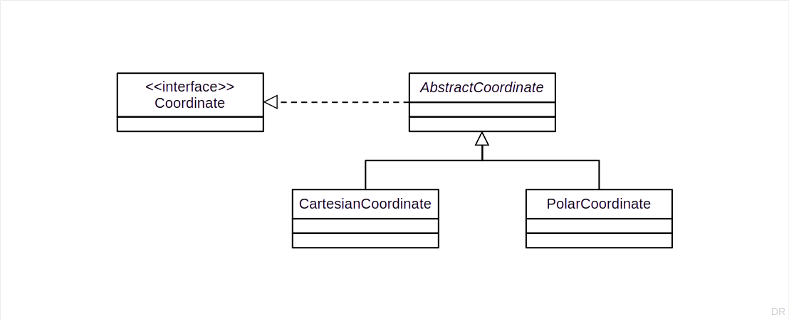
Extended Coordinate Example

Slide 49
Coordinate Interface
import { Equality } from "./Equality";
import { Cloneable } from "./Cloneable";
export interface Coordinate extends Equality, Cloneable {
reset(): void;
getX(): number;
setX(x: number): void;
getY(): number;
setY(y: number): void;
calcStraightLineDistance(other: Coordinate): number;
getR(): number;
setR(r: number): void;
getPhi(): number;
setPhi(phi: number): void;
calcGreatCircleDistance(other: Coordinate): number;
}

Slide 50
6. Method Implementation

Slide 51
Regular Method
A regular method is (just)
A method that performs some task, for which it usually relies on further methods
Examples
initialize(x?: number, y?: number): void
Prefixes
None specifically
Naming
None specifically

Slide 52
Regular Method Examples
public isEqual(other: Coordinate): boolean {
return (this.getX() == other.getX()) && (this.getY() == other.getY());
}
public calcStraightLineDistance(other: Coordinate): number {
let deltaX: number = Math.abs(other.getX() - this.getX());
let deltaY: number = Math.abs(other.getY() - this.getY());
return Math.hypot(deltaX, deltaY);
}

Slide 53
Composing Method
A composing method is
A method that organizes a task into several subtasks as a linear succession of method calls to other regular or primitive methods
Examples
initialize(x?: number, y?: number): void
Prefixes
None specifically
Naming
Adapted from Beck (1997)

Slide 54
Composing Method Example
public initialize(x?: number, y?: number): void {
if (x != undefined) {
this.setX(x);
}
if (y != undefined) {
this.setY(y);
}
}

Slide 55
Primitive Method
A primitive method is
A method that carries out one specific task, usually by directly engaging the object’s implementation state; it does not use any non-primitive methods
Examples
doSetX(x: number): void
Prefixes
do, basic
Naming
Prefix + name of the logical or implementation state

Slide 56
Primitive Method Example
public setX(x: number): void {
this.assertIsNotNullOrUndefined(x);
this.doSetX(x);
}
protected doSetX(x: number): void {
this.x = x;
}
public setPhi(phi: number): void {
this.assertIsNotNullOrUndefined(phi);
this.assertIsValidPhi(phi);
let r: number = Math.hypot(this.getX(), this.getY());
let x: number = r * Math.cos(phi);
let y: number = r * Math.sin(phi);
this.doSetX(x);
this.doSetY(y);
}

Slide 57
Null Method
A null method is
A method with an empty implementation
Examples
See Template Method example
Prefixes
None specifically
Naming
None specifically

Slide 58
7. Inheritance Properties

Slide 59
Template Method
A template method is
A method that defines an algorithmic skeleton by breaking a task into subtasks the implementation of which is delegated to subclasses
Examples
Main.run()
Prefixes
None specifically
Naming
Taken from Gamma et al. (1995)

Slide 60
Template Method Example
export class Main {
public run(args: string[]): void {
this.parseArgs(args);
this.initialize();
this.execute();
this.finalize();
};
protected parseArgs(args: string[]): void {
// do nothing
}
protected initialize(): void {
// do nothing
}
protected execute(): void {
// do nothing
}
protected finalize(): void {
// do nothing
}
}

Slide 61
Hook Method
A hook method is
A method that declares a well-defined task for overriding through subclasses
Examples
Main.parseArgs / initialize / execute / finalize
Prefixes
None specifically
Naming
None specifically

Slide 62
8. Convenience Methods

Slide 63
Convenience Method
A convenience method is
A method that simplifies the use of another, more complicated method by providing a simpler signature and by using default arguments
Examples
reset(): void
Prefixes
None specifically
Naming
None specifically

Slide 64
Convenience Method Example
public reset(): void {
this.initialize(0, 0);
}

Slide 65
Default-Value Method
A default-value method is
A default-value method is a method that returns a single predefined value
Examples
static getOrigin(): Coordinate
Prefixes
None specifically
Naming
None specifically, but typically also a getter

Slide 66
Default-Value Method Example
public static getOrigin(): Coordinate {
return new Coordinate(0, 0);
}

Slide 67
9. Design Guidelines

Slide 68
Single Method Purpose Rule
Single method purpose rule
A method should have one purpose only
Benefits of single-purpose rule
Makes methods easier to understand
Makes overriding methods easier

Slide 69
Exceptions to Single Purpose Rule
Well-known idioms
Increment and return value (iteration)
Technical requirements
Test and set value (critical sections)
Lazy initialization

Slide 70
Documenting Method Types and Properties
Use annotations

Slide 71
Summary
Method types
Query methods
Mutation methods
Helper methods
Method properties
Implementation related
Inheritance related
Convenience methods
Design guidelines

Slide 72
Thank you! Any questions?
dirk.riehle@fau.de – https://oss.cs.fau.de
dirk@riehle.org – https://dirkriehle.com – @dirkriehle

Slide 73
Legal Notices
License
Licensed under the CC BY 4.0 International license
Copyright
© 2012, 2018, 2024 Dirk Riehle, some rights reserved

